Slide 1
City of Riverbank Capital Projects
Presented to City Council for Fiscal Year 2023-2028

Slide 2
5-Year Capital Improvement Plan (CIP) The CIP is not a budget document, but rather a planning tool to be used in conjunction with the budget document. It is a work in progress document to show transparency in the projects staff is currently managing, planning, and researching funding sources. Each project requires a specific implementation and financing plan, possible environmental review, and at times collaboration with other agencies.

Slide 3
STREET & STORM PROJECTS PROGRAMMED FY 2023/2024

Slide 4
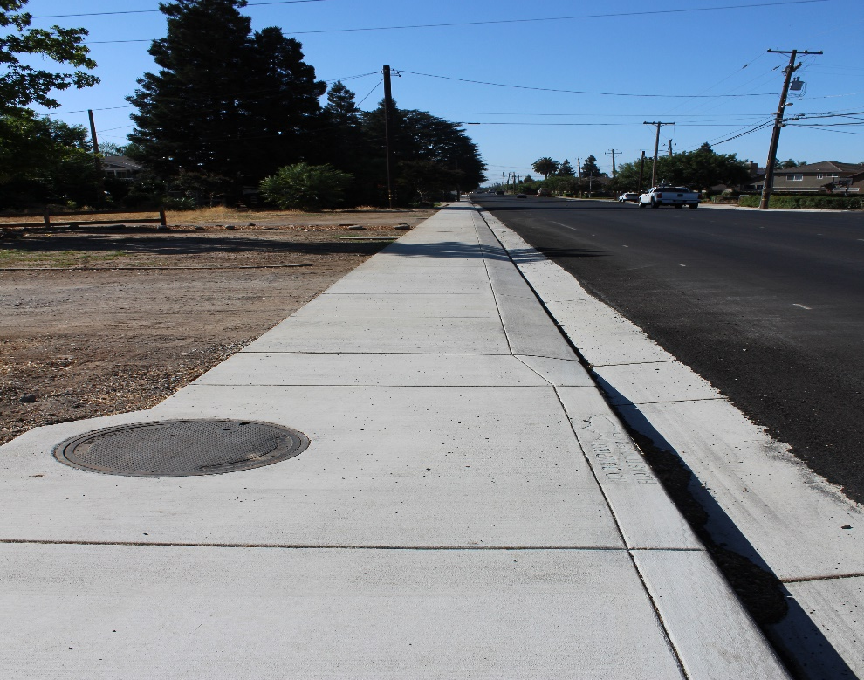
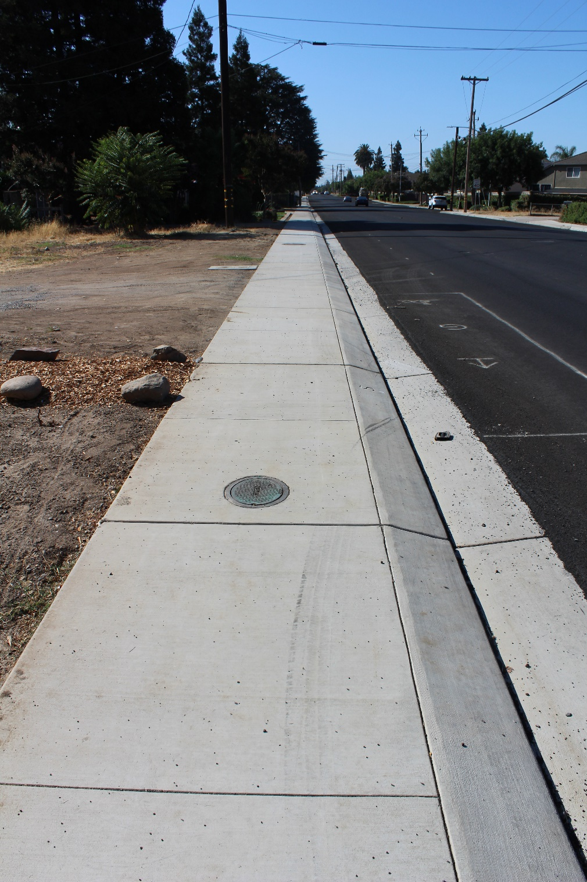
Roselle Avenue Sidewalk & ADA Improvements Preliminary Engineering, Environmental & Construction Total Cost: $415,400 Construction: Completed Funding: Measure L STBGP Fund 116

Slide 5
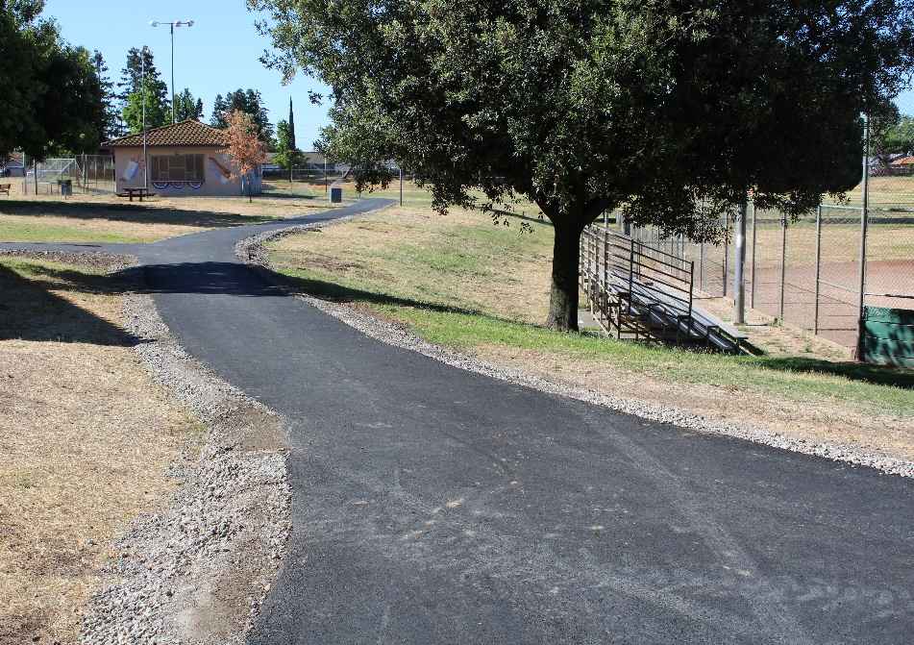
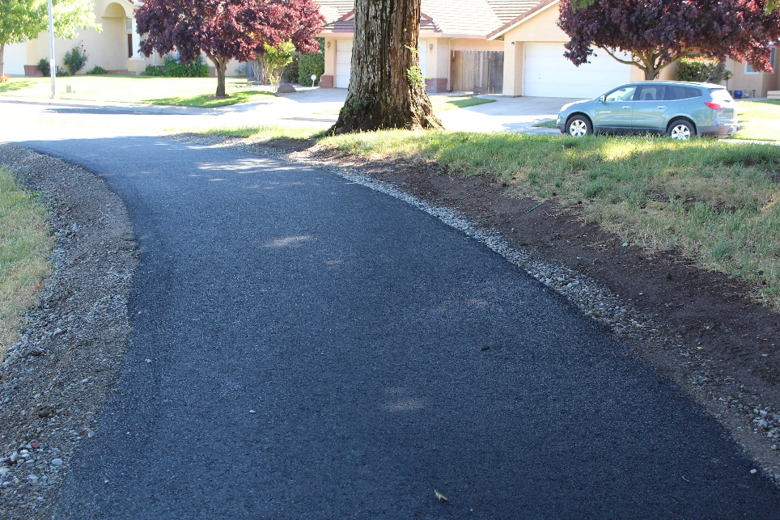
Castleberg Park Trail Engineering & Construction Total Cost: $283,388 Construction: Construction Completed Funding: CDBG Fund 156

Slide 6
Riverbank Police Fencing Engineering & Construction Total Cost Estimate: $344,923 Construction: Currently Under Construction Funding: ARPF

Slide 7
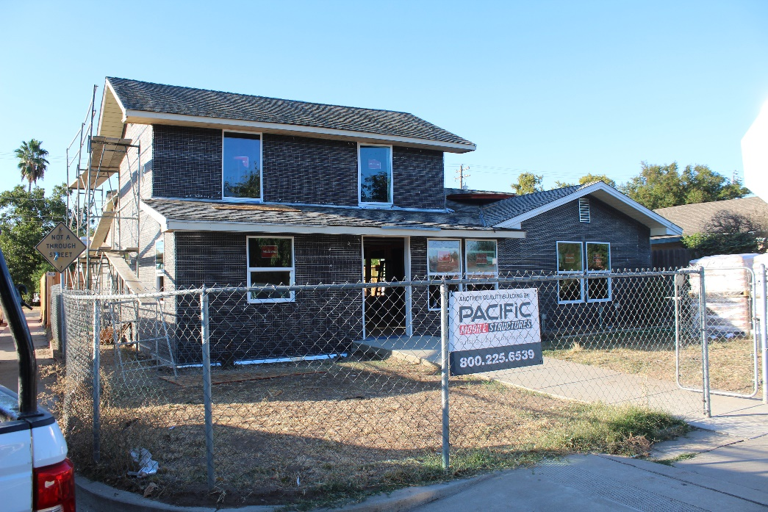
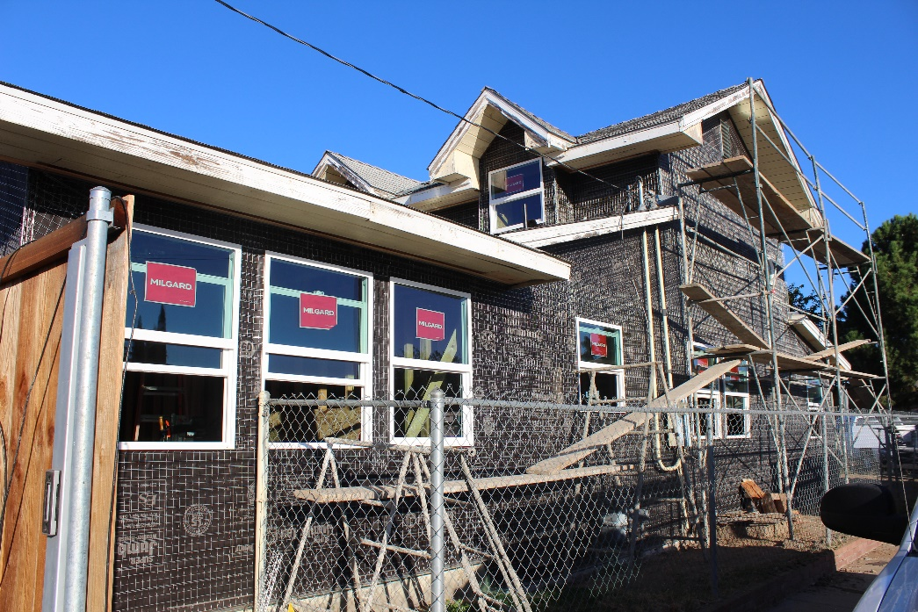
Sierra House 3344 Sierra Street Design & Construction Total Cost Estimate: $558,030 Construction: Currently Under Construction Funding: ARPF

Slide 8
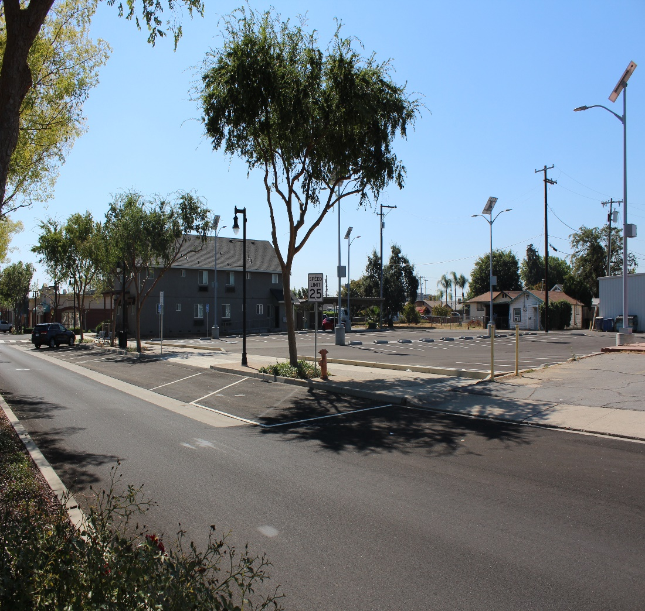
Third Street Parking Lot Preliminary Engineering & Construction Total Cost Estimate: $371,609 Construction: Completed Funding: ARPF

Slide 9
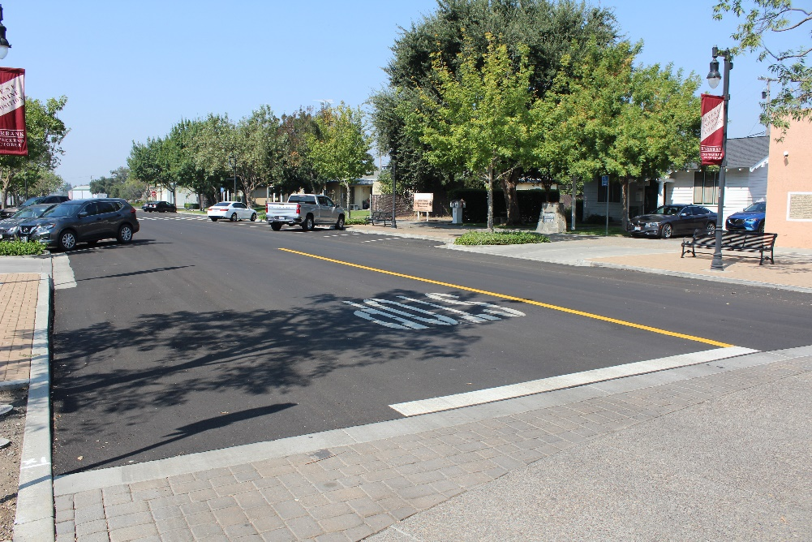
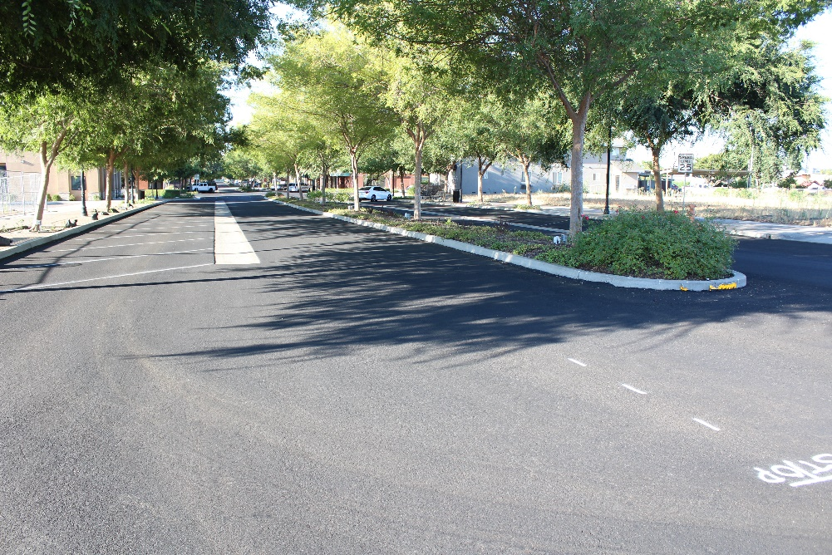
Pavement Restoration Project – Various Roads Preliminary Engineering & Construction Total Cost Estimate: $795,000 Construction: Summer 2023 – Waiting for final striping on Roselle Funding: Measure L

Slide 10
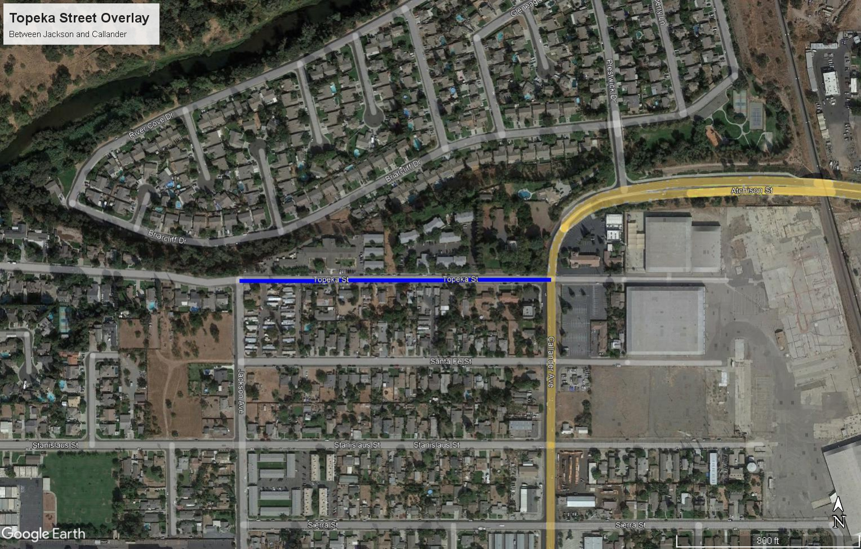
Topeka Street Overlay & ADA Improvements – Jackson Avenue to Callander Preliminary Engineering Construction Total Cost Estimate: $555,694 Construction: Currently Under Construction Funding: SB-1

Slide 11
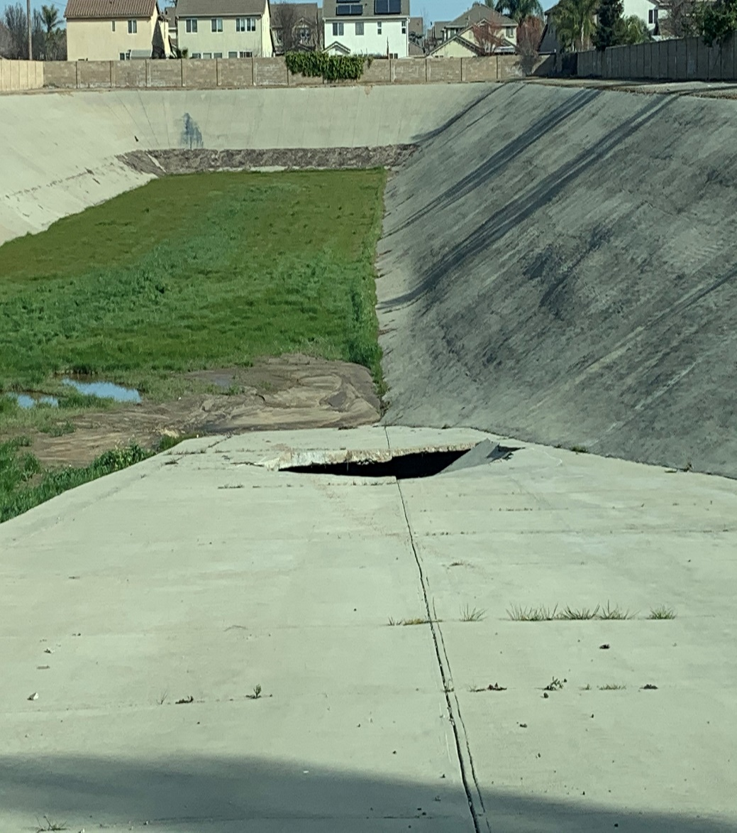
Storm Outfall Ramp Repair (Homewood Basin) Preliminary Engineering & Construction Total Cost Estimate: $240,000 Construction: Fall 2023 Funding: Fund 413 Fund 172 Fund 116

Slide 12
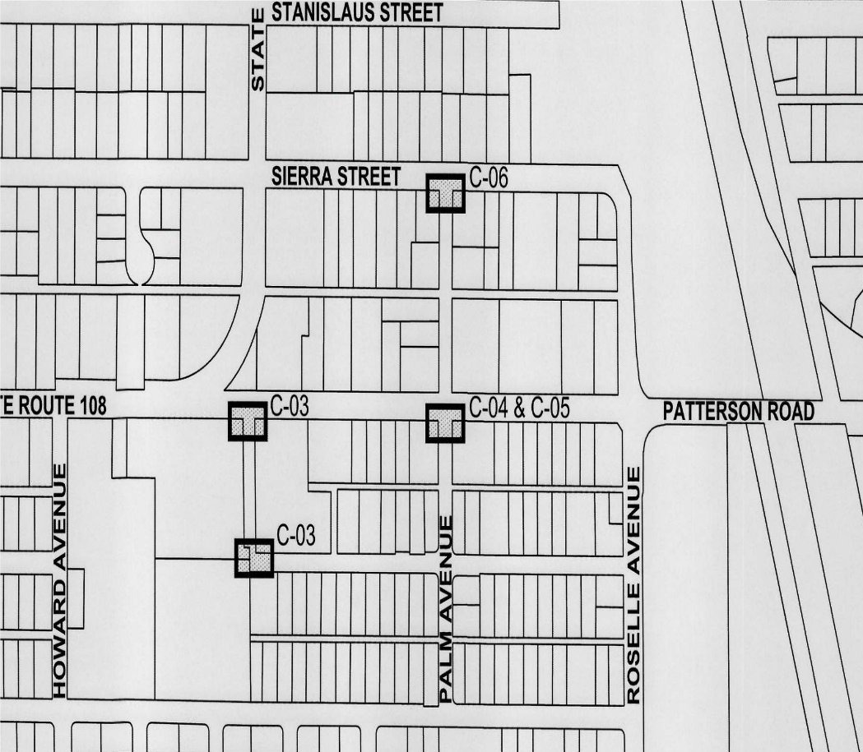
Drywell Rehabilitation Project (Palmer & Patterson and Sierra & Palmer) Preliminary Engineering & Construction Total Cost Estimate: $207,157 Construction: Fall 2023 Funding: SB-1

Slide 13
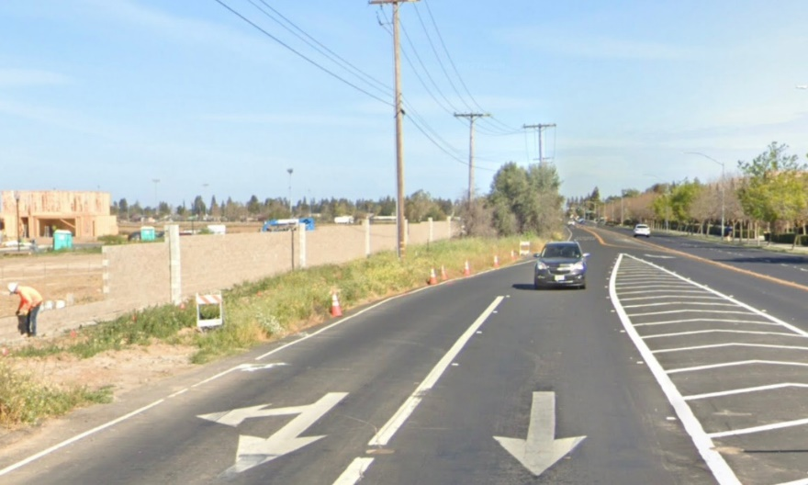
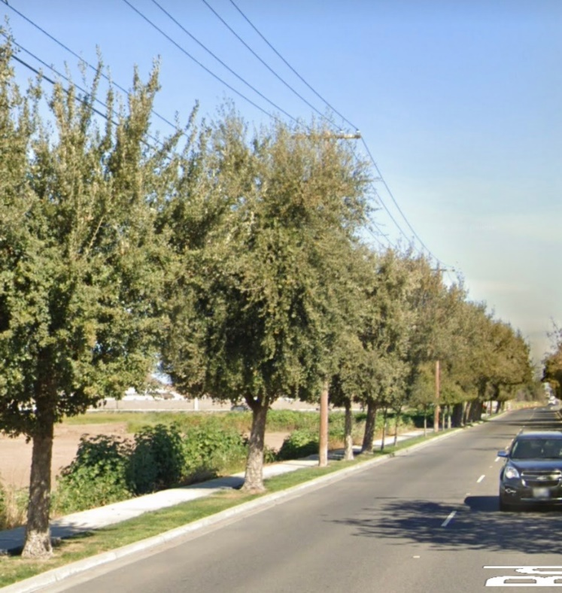
Oakdale Road Improvements (MID Canal to Northerly Limits of Crossroads West Unit 1) Construction Total Cost Estimate: $1,904,914 Construction: Spring 2024 Funding: Fund 205

Slide 14
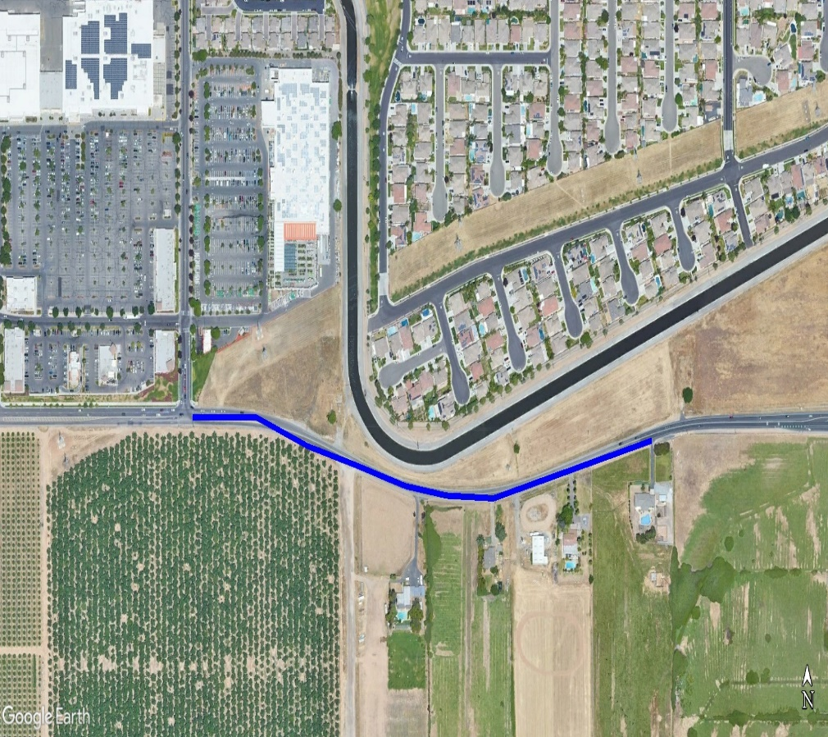
Claribel Road Overlay Project – Joint Project with Stanislaus County Preliminary Engineering & Construction Total Cost Estimate: $728,184 (County’s portion $280,013) Estimated Construction: Spring 2024 Funding: Measure L

Slide 15
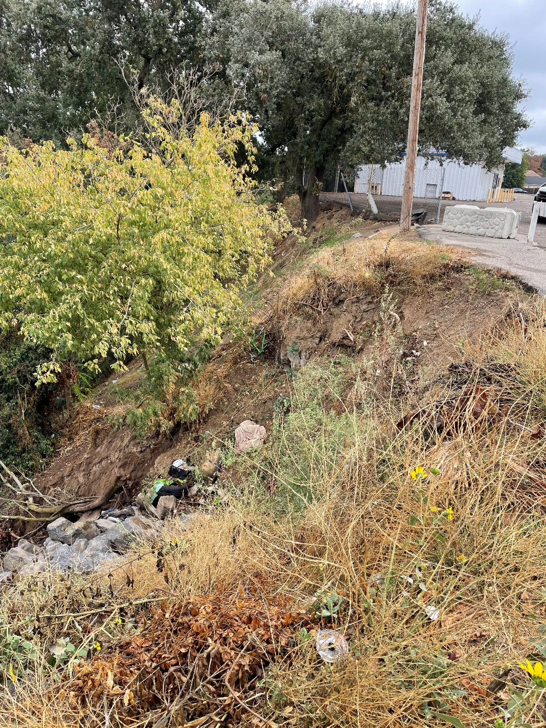
Seventh Street Outfall Repair Preliminary Engineering & Construction Total Cost Estimate: $780,951 Construction: Fall 2023 Funding: ARPF

Slide 16
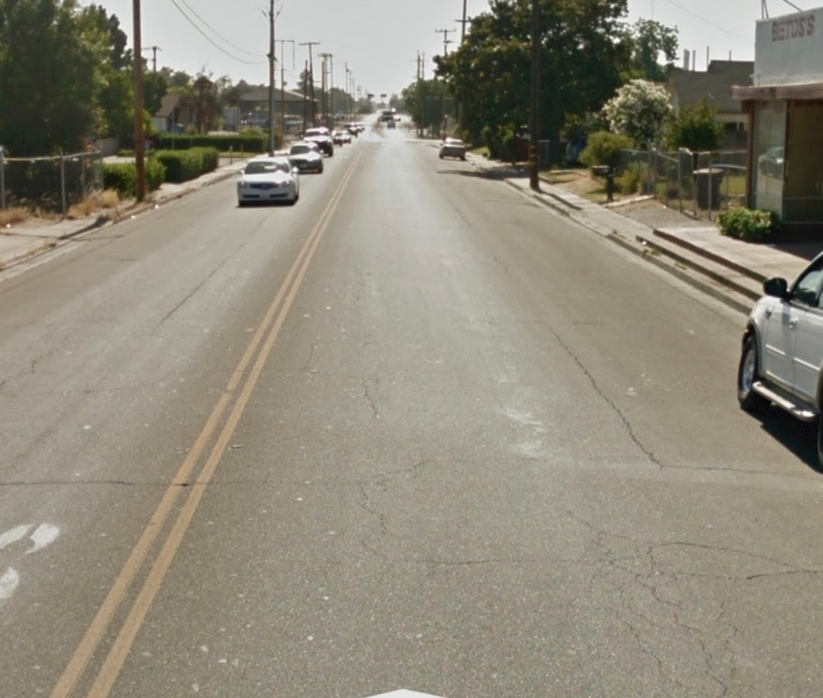
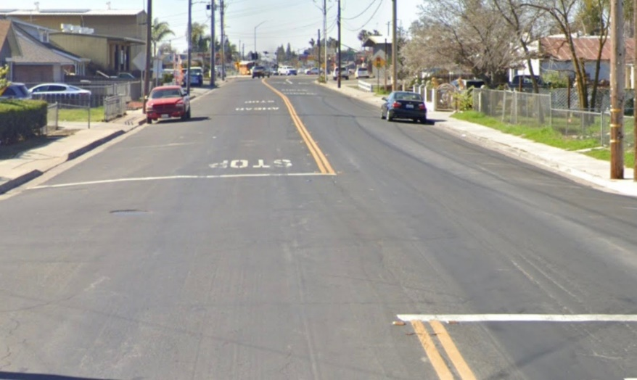
Patterson Road Sidewalk & ADA Improvements (Callander Avenue to Roselle Avenue) Preliminary Engineering, Environmental & Construction Total Cost Estimate: $514,030 Estimated Construction: Late Spring 2024 Funding: CMAQ - Construction

Slide 17
UPCOMING STREET PROJECTS PROGRAMMED FY 2024/2025

Slide 18
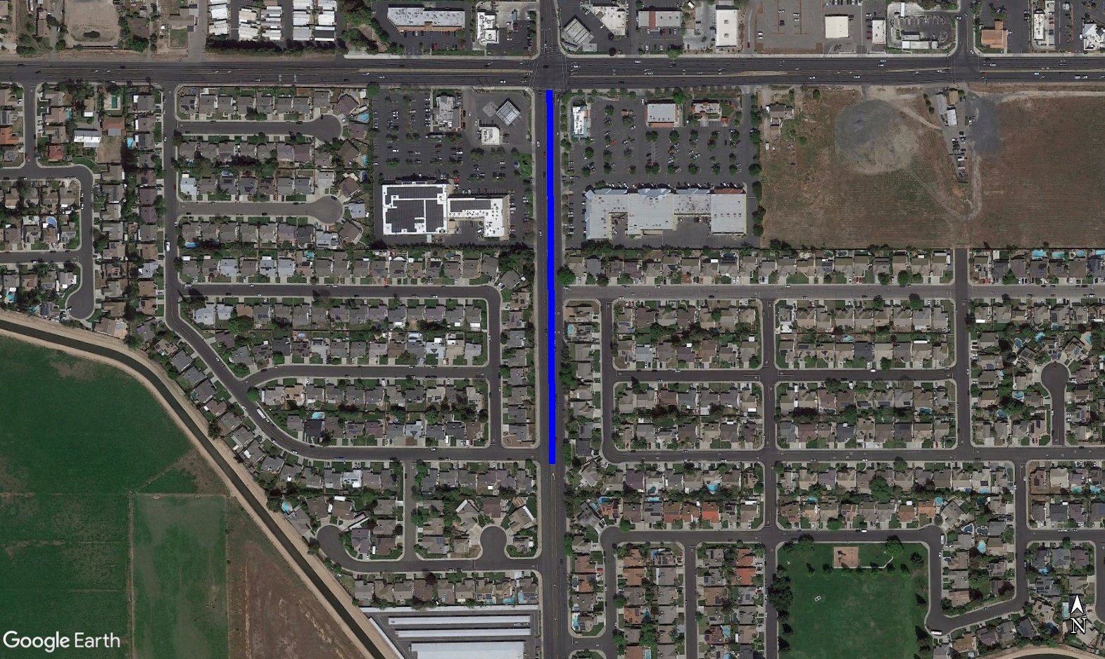
Oakdale Road Overlay – Silverock to Patterson Road Preliminary Engineering & Construction Total Cost Estimate: $626,500 Estimated Construction: Spring 2024 Funding: Measure L

Slide 19
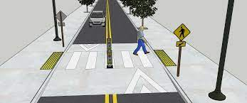
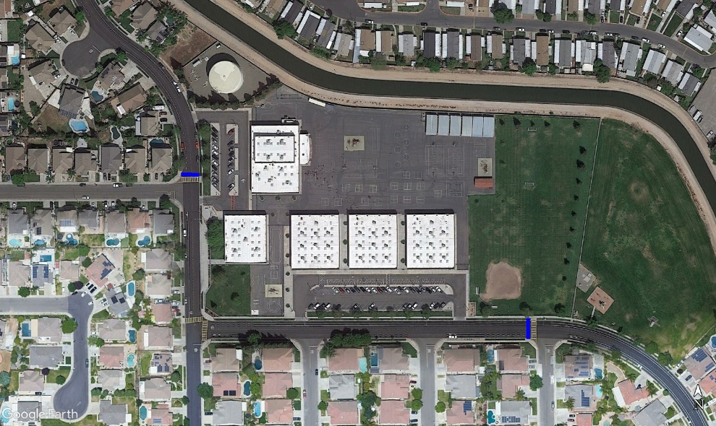
Crossroads Elementary School – Two Raised Crosswalks Prospector’s Prkwy @ Novi & Suttermill Preliminary Engineering & Construction Total Cost Estimate: $114,500 Estimated Construction: Summer 2024 Funding: Measure L

Slide 20
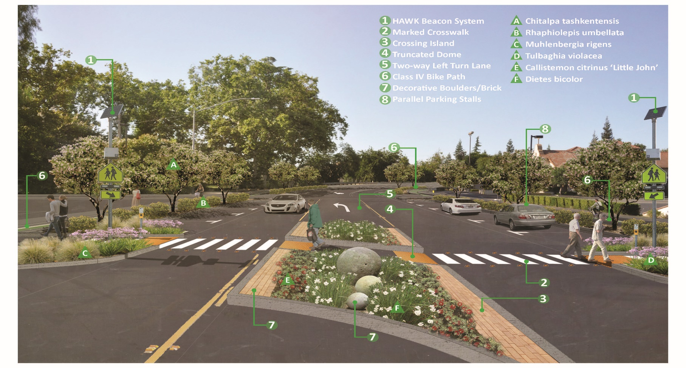
Callander Avenue Improvements
Design & Preliminary Engineering Phase I - Completed
Construction Phase I - Fall 2022 or Spring 2023
Funding: Measure L $430,217, RSTP $271,276, STBGP $200,000
TOTAL: $901,493

Slide 21
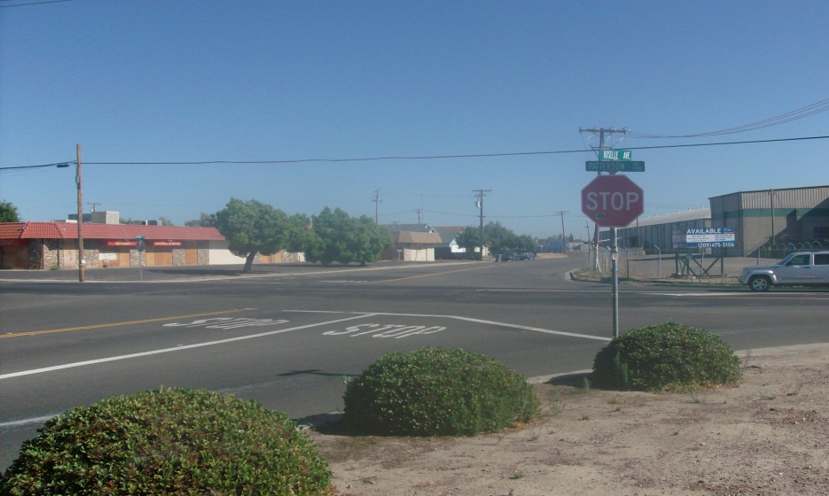
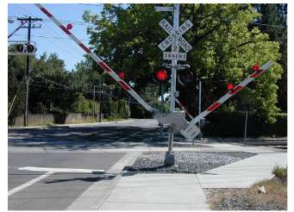
Signal at Roselle & Patterson, Pedestrian RR Crossing, Sidewalk Infill along Roselle & Patterson Roads Environmental is complete. All right of way has been dedicated. Utility relocation is complete Finalizing plans with BNSF Total Cost Estimate: $2,580,093(Construction) Estimated Construction: Fall 2022 or Spring 2023 Funding: CMAQ - $1,425,695 STBGP - $554,398 Fund 205 - $600,000

Slide 22
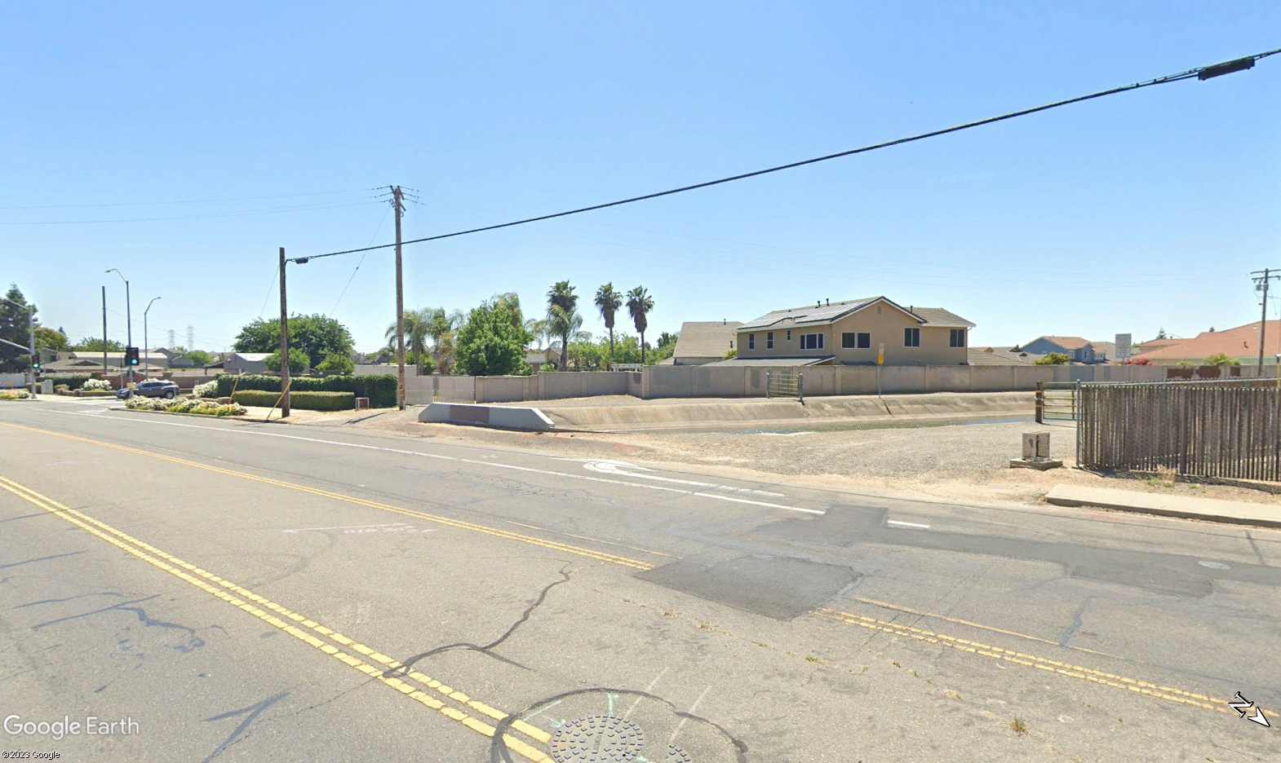
Roselle Avenue Pedestrian Access over MID Canal Preliminary Engineering, Environmental & Construction Total Cost Estimate: $399,850 Estimated Construction: Fall 2024 Funding: CMAQ

Slide 23
Roselle & S. Rosebrook Intersection Preliminary Engineering & Construction Total Cost Estimate: $385,000 Estimated Construction: Summer 2024 Funding: Measure L

Slide 24
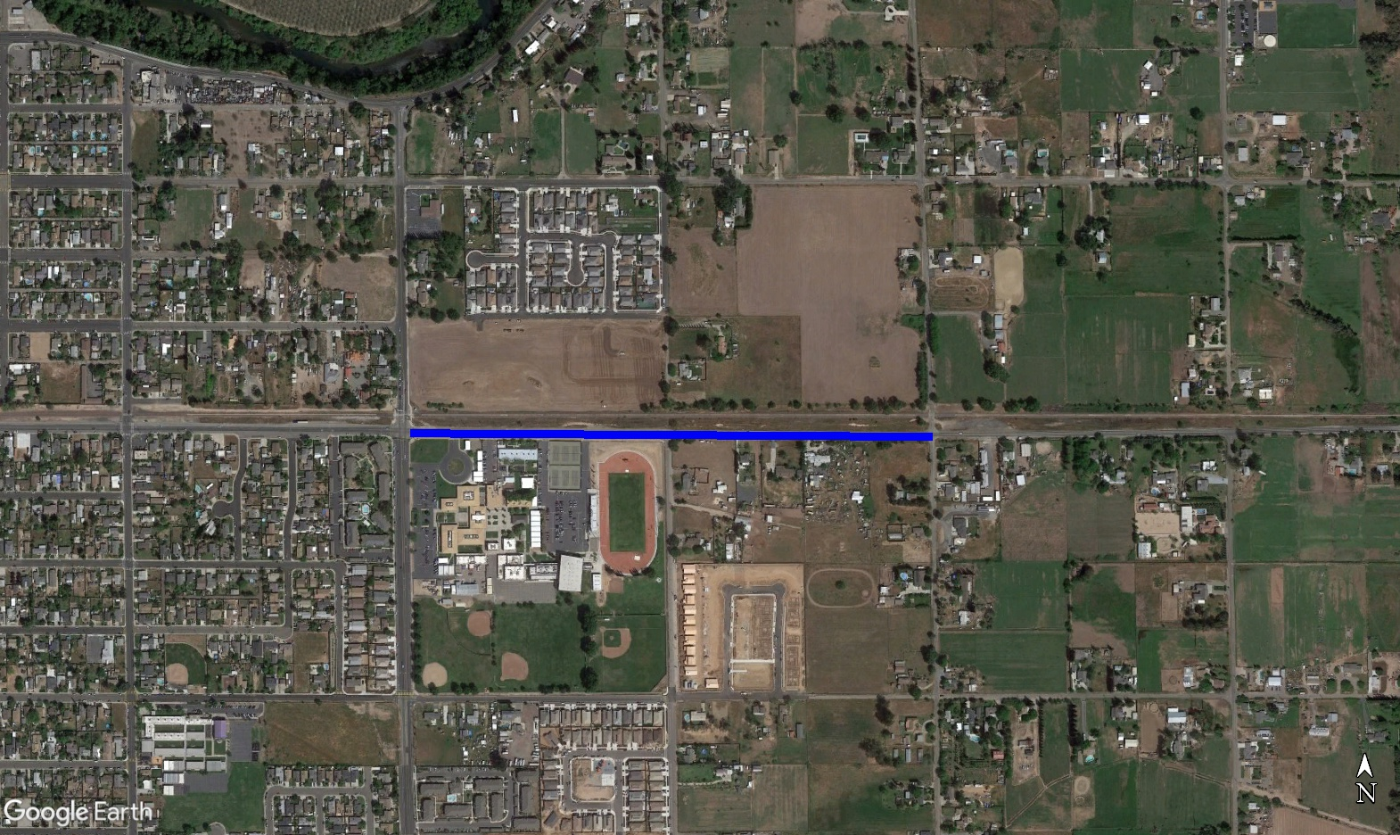
Patterson Road Overlay – Claus to Snedigar Preliminary Engineering, Environmental & Construction Total Cost Estimate: $612,678 Estimated Construction: Fall 2024 Funding: Measure L STBGP

Slide 25
Recommendation The City Council adopt the 5-Year Capital Improvement Plan for Fiscal Year 2023-2028.

